Slide 1

TECHNOLOGY TRENDS ANALYSIS
Siddhartha raghuwanshi
September,2025

Slide 2

• Executive Summary
• Introduction
• Methodology
• Results
- Charts
- Dashboards
• Discussion
• Findings & Implications
• Conclusion
• Appendix
OUTLINE

Slide 3

EXECUTIVE
SUMMARY
1
Evolving Trends in Programming Languages.
This survey analyzes developer trends across programming languages, databases, platforms, and frameworks. The insights highlight current technology usage and future preferences.
2
Emerging Trends in Database Systems.
3
Demographic Analysis.
4
Global Technology Gap.
5
Workplace Age Gap.

Slide 4

INTRODUCTION
The developer survey provides insights into global technology adoption patterns, career aspirations, and tool preferences across diverse demographics.
PURPOSE
Recognizing Future Skill Needs.
What are the most in-demand skills for database professionals?
Which programming languages have the highest demand?
What platforms are most popular right now?
What developers use today, what they seek tomorrow, and who they represent.

Slide 5

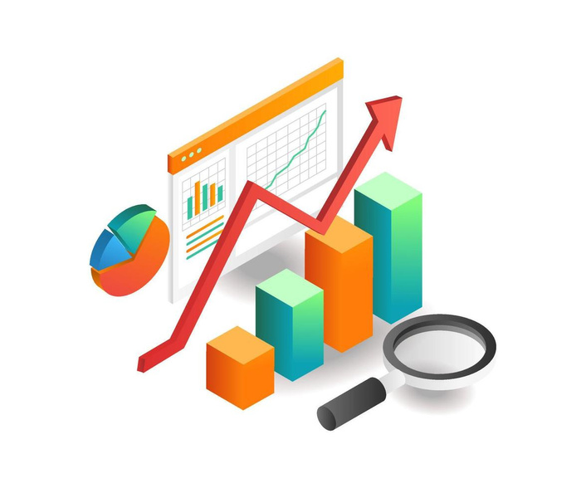

METHODOLOGY
The study used a subset of data from the Stack Overflow Developer Survey 2024, collected through an online survey of developers worldwide. The process involved:
Data Gathering: Extracting relevant responses from the survey dataset.
Data Exploration: Reviewing patterns and distributions in developer responses.
Data Cleaning: Handling missing values and standardizing multiple-value fields.
Data Visualization: Creating plots to highlight trends in programming languages, databases, and frameworks.
Dashboarding: Presenting findings through interactive visualizations for clearer insights.

Slide 6
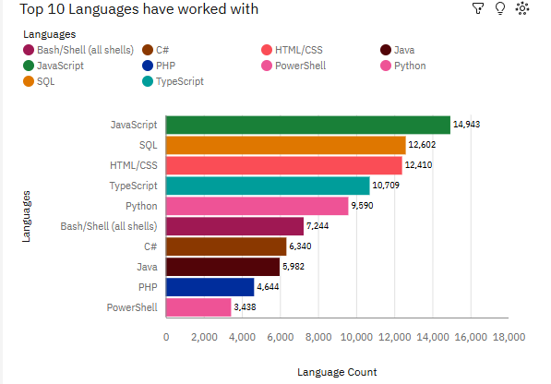
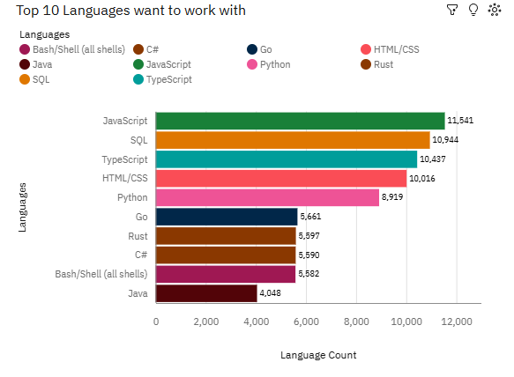
PROGRAMMING LANGUAGE TRENDS

Slide 7
PROGRAMMING LANGUAGE TRENDS - FINDINGS & IMPLICATIONS
FINDINGS
IMPLICATIONS
JavaScript dominates both in current use and future preference, showing its continued relevance.
Rust and Go will likely gain traction in systems programming, cloud, and backend development
signaling where future demand may rise.
SQL and HTML/CSS are also highly used and remain strong in future interest, highlighting their foundational role.
Mastery in JavaScript, SQL, TypeScript, and Python offers immediate and future opportunities.
Older languages like PHP, Java, and C# show declining enthusiasm: while still widely used, fewer developers list them as a future choice.
SQL and HTML/CSS remain highly relevant, ensuring web and database development expertise stays essential.
Python ranks higher demand in future.
JavaScript dominates both in current use and future preference, showing its continued relevance.

Slide 8
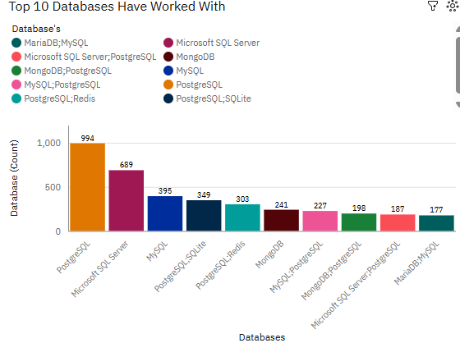
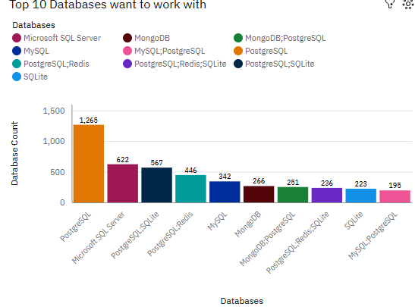
DATABASE TRENDS

Slide 9
PROGRAMMING LANGUAGE TRENDS - FINDINGS & IMPLICATIONS
FINDINGS
IMPLICATIONS
PostgreSQL leads both categories, being the most commonly worked with and the most desired for future work, indicating its strong popularity and perceived value.
The dominance of PostgreSQL in both actual use and future interest suggests it is viewed as a versatile, modern, and reliable database management system, likely to see increased adoption and support in the developer ecosystem.
Greater interest in blends and secondary databases like PostgreSQL-SQLite and PostgreSQL-Redis points to expanding interest in specialized, flexible, or hybrid data storage approaches, perhaps driven by evolving project requirements or advancements in cloud and distributed systems
Microsoft SQL Server ranks second in both actual usage and future interest, showing its entrenched role in developer skillsets and persistent demand.
MySQL usage is higher than future interest, while MongoDB shows stable interest, pointing to steady relevance but less aspirational growth
Organizations and educators may want to focus training and project opportunities around PostgreSQL and innovative combinations, as these align best with both current developer expertise and future aspirations.
Some databases, such as MariaDB and combinations like MySQL-PostgreSQL, rank lower in both usage and desire, suggesting niche application or lesser popularity.
The consistent but less aspirational ranking of MySQL and Microsoft SQL Server implies these technologies remain foundational but may be seen as more traditional or mature, with growth plateauing compared to PostgreSQL.

Slide 10
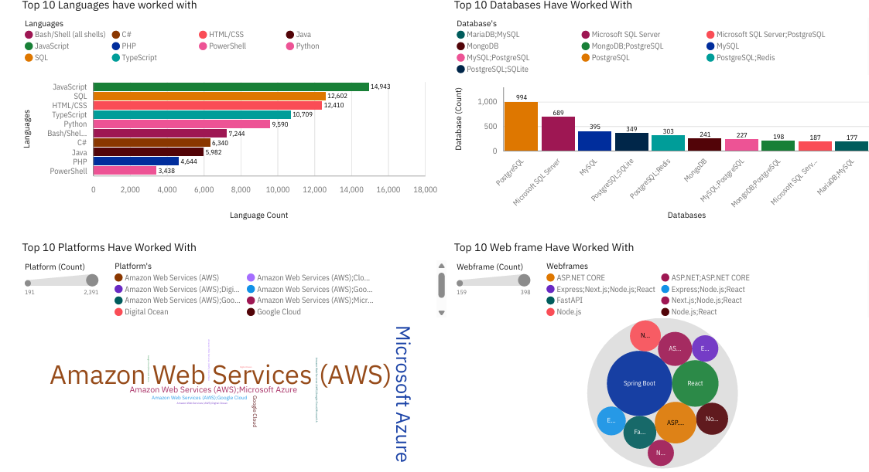
CURRENT TECHNOLOGY USAGE

Slide 11
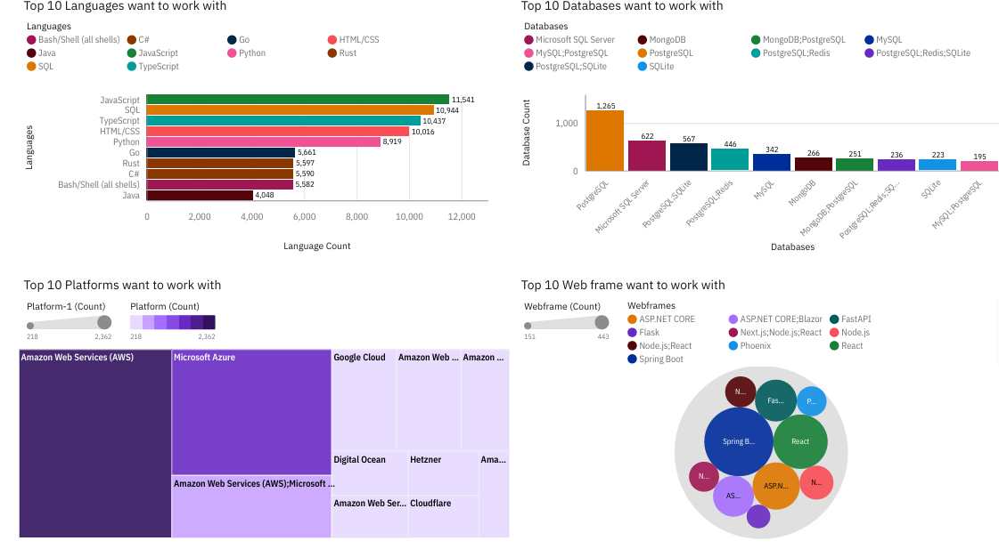
FUTURE TECHNOLOGY TREND

Slide 12
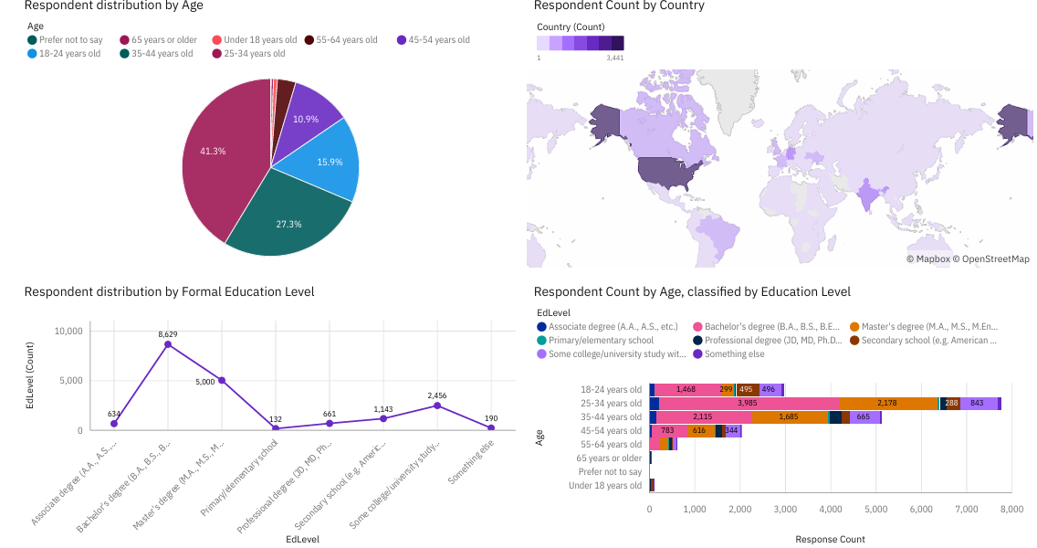
DEMOGRAPHICS

Slide 13
DISCUSSION
1
Ongoing and Upcoming Technology Trends
2
Reducing the Technology Disparity Among Countries.
3
Involvement of Under-18s in Technology.
Ending Age and Education Bias in
Employment.
4
5
Workforce Development and Reskilling.

Slide 14
OVERALL FINDINGS & IMPLICATIONS
Findings
Implications
1
1
Adoption of Faster Deployment Cycles and Cloud Services Ahead.
Age Inequality in the Tech Workforce.
2
2
Companies must stay adaptable to keep up with rapid transformations.
Quickly Shifting Technology Landscape.
3
Cloud platforms such as AWS and Azure are expanding.
3
Expanding technology reach to underdeveloped nations.
4
Spring Boot is an emerging in demand Web frame for the future.
4
Influence on Hiring Practices.

Slide 15
CONCLUSION
The majority of programmers originate from developing countries.
1
Developers aged 25–34 make up a large proportion of the workforce.
2
3
We have to keep monitoring Current Tech Landscape and upcoming Year’s Trends.
4
A large proportion of developers have a bachelor’s degree.

Slide 16
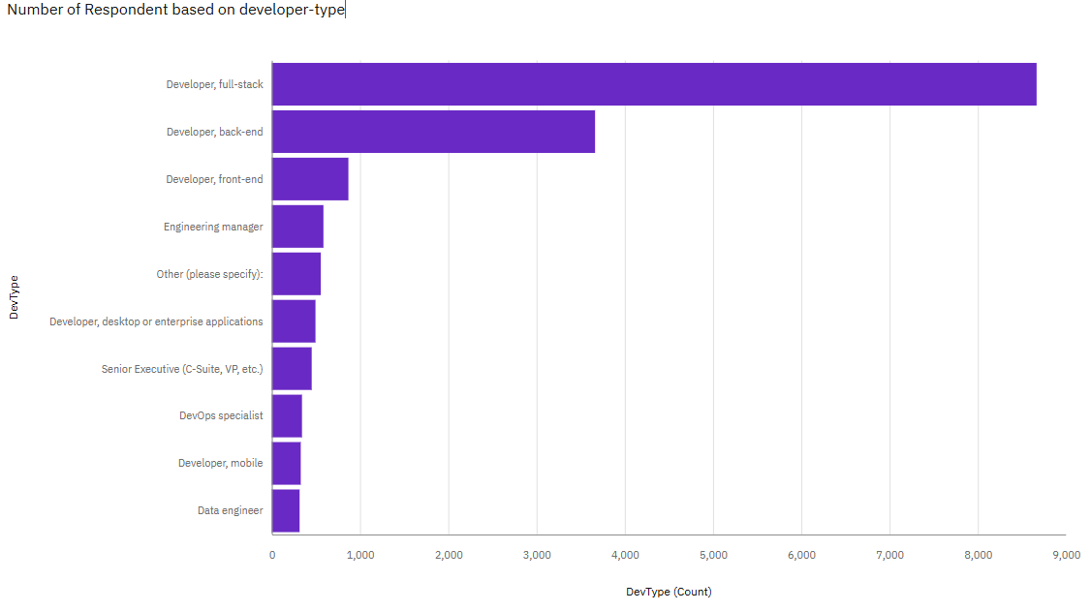
APPENDIX
RESPONDENT BASED ON DEVELOPER-TYPE

Slide 17
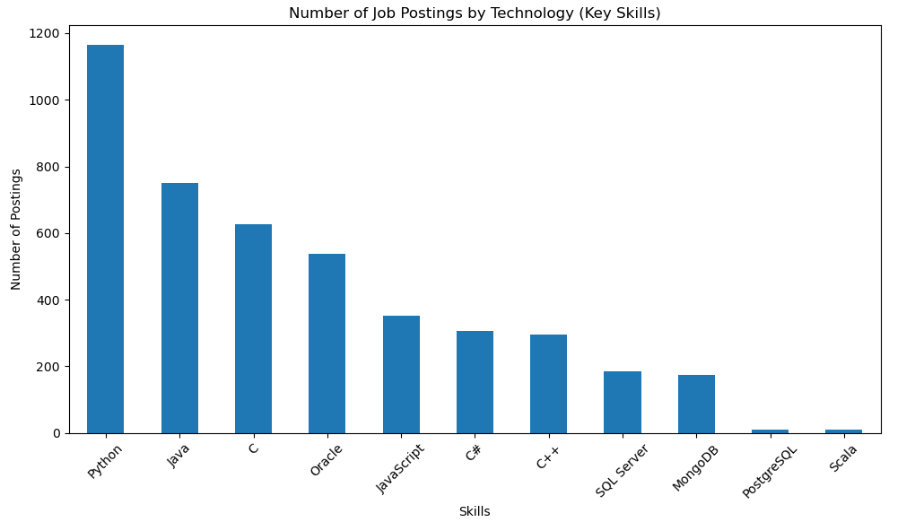
JOB POSTING

Slide 18
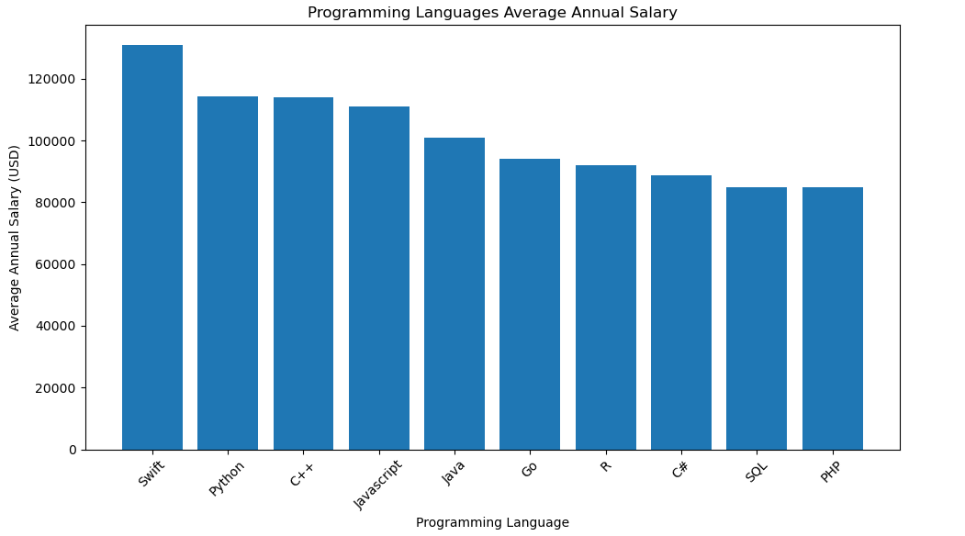
PROGRAMMING LANGUAGE
SALARY INSIGHTS

Slide 19


THANK YOU
PROJECT LINK-
https://github.com/Siddhartha-Raghuwanshi/Technology-Trends-Survey-2024/blob/1bd2069b0ac978c965eefcd8427afb4121caa652/README.md

